Slide 1
Biology
Unit 2: The Living Systems
Lesson 2: Carbon-Based Molecules
Notes:
The learning experiences in this unit prepare students for the mastery of
Performance Expectations
HS-LS1-6 Construct and revise an explanation based on evidence for how carbon, hydrogen, and oxygen from sugar molecules may combine with other elements to form amino acids and/or other large carbon-based molecules.

Slide 2




Can You Explain It?
Unit 2 Lesson 2
The universe is made up of many different elements, but one of the most important elements in living things is carbon. It is often called the element of life because carbon atoms are the basis of biomolecules, molecules that make up living things.
How do you think carbon can be the central component of so many different types of molecules?

Slide 3
Properties of Carbon
Unit 2 Lesson 2
Organic chemistry refers to the chemistry of carbon-based molecules, because living organisms are responsible for the production of nearly all naturally occurring carbon compounds.
PREDICT
Why do you think carbon has an entire branch of chemistry devoted to its study?

Slide 4
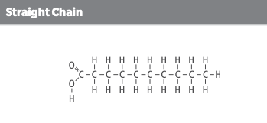
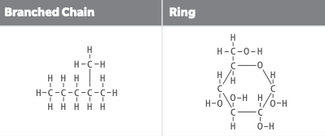
Properties of Carbon
Unit 2 Lesson 2
Explain
Compare the shapes of the molecules shown. What is similar? What differs?

Slide 5
Properties of Carbon
Unit 2 Lesson 2
ANALYZE
How is the number of bonds carbon can make related to its ability to form molecules with many different shapes?

Slide 6
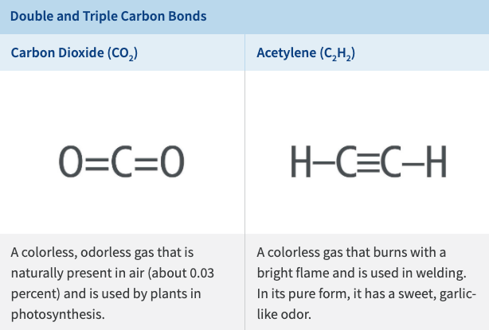
Properties of Carbon
Unit 2 Lesson 2
Which is the strongest type of covalent bond—a single, double, or triple bond?

Slide 7
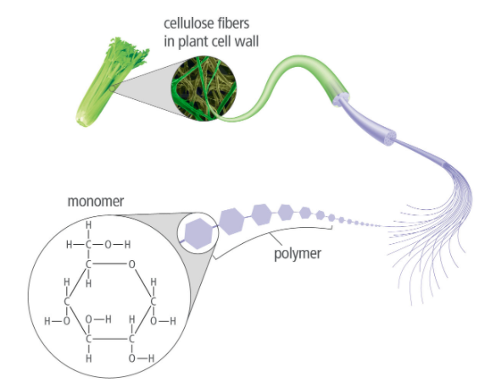
Monomers and Polymers
Unit 2 Lesson 2
A polymer is a large molecule made of subunits called monomers.
Carbon compounds that contain only carbon and hydrogen and are a class of compounds called hydrocarbons.

Slide 8
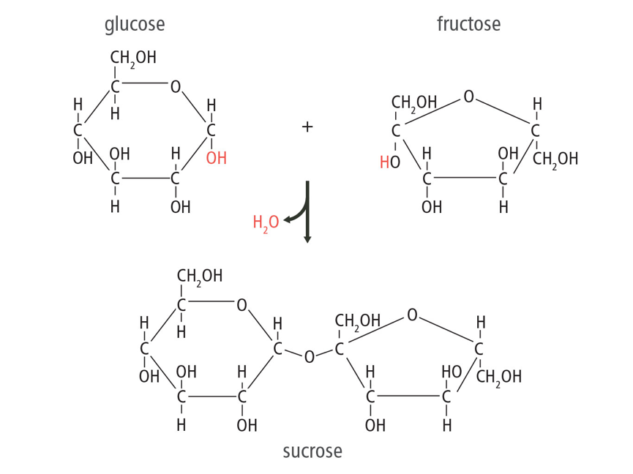
Monomers and Polymers Engineering: Making Polymers
Unit 2 Lesson 2
What might be some of the economic and environmental tradeoffs of producing clothes from human-made polymers, such as nylon, and polyester versus natural polymers, such as cotton?

Slide 9
Monomers and Polymers
Unit 2 Lesson 2
EXPLAIN
Compare and contrast the different types of carbon structures in terms of their structures, chemical formulas, and functions.

Slide 10
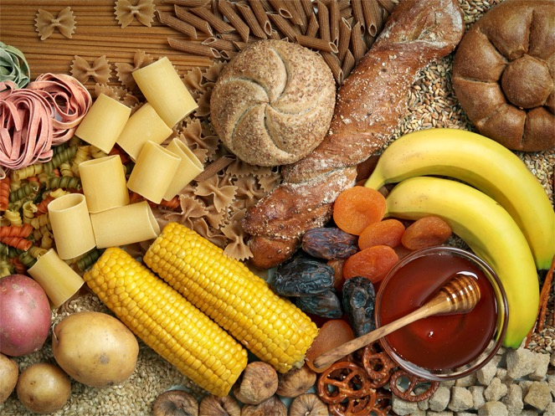
Structure and Function of Carbon-Based Molecules
Unit 2 Lesson 2
Carbohydrates are composed of carbon, hydrogen, and oxygen. The most basic carbohydrates are simple sugars, or monosaccharides.
Carbohydrate-rich foods such as bread, pasta, vegetables, fruit, and sweeteners contain carbohydrate molecules that your body breaks down to release usable energy.
Why does it take longer for your body to break down complex carbohydrates than simple carbohydrates?

Slide 11

Structure and Function of Carbon-Based Molecules
Unit 2 Lesson 2
Lipids are similar to carbohydrates in that they contain many of the same elements. Unlike carbohydrates, lipids are nonpolar molecules. Thus, most lipids are insoluble in water because water molecules are polar.
How does secreting oil onto their fur help otters maintain homeostasis?

Slide 12
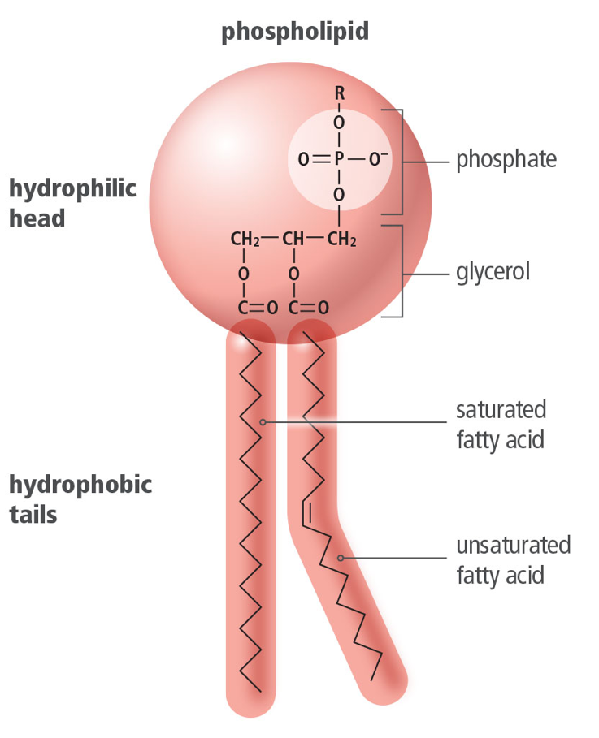
Structure and Function of Carbon-Based Molecules
Unit 2 Lesson 2
A phospholipid is a lipid that consists of glycerol, two fatty acids, and a phosphate group.
The "head" of the phospholipid is made up of the glycerol backbone and the phosphate group.

Slide 13
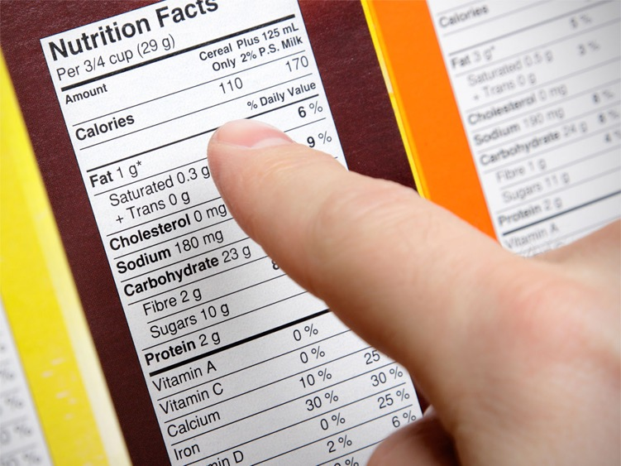
Structure and Function of Carbon-Based Molecules
Unit 2 Lesson 2
Cholesterol is an example of a lipid with a fused ring structure.
The ability to make cholesterol is important because it is an important part of cell membranes.
A nutrition label shows how many milligrams of cholesterol are present in your food.

Slide 14
Structure and Function of Carbon-Based Molecules
Unit 2 Lesson 2
EXPLAIN
Excess cholesterol has been linked to heart disease, so the labels on some food products contain wording such as "cholesterol-free." Is it necessary to eat a completely cholesterol-free diet? Explain your answer.

Slide 15
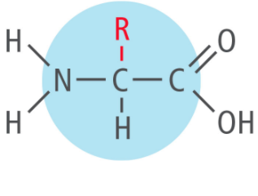
Protein Structure and Function
Unit 2 Lesson 2
Proteins are often described as the building blocks of life. They play many essential roles in organisms.
Many proteins function as enzymes, which help regulate chemical reactions within our bodies.
The building blocks for proteins are amino acids.
Amino acids have a carbon atom bonded to a hydrogen atom, an amino group (NH₂), and a carboxyl group (COOH).

Slide 16

Nucleic Acid Structure and Function Hands-On Lab: Modeling Biochemical Compounds
Unit 2 Lesson 2
Model a variety of biomolecules to better understand how atoms are arranged in these large molecules.

Slide 17
Nucleic Acid Structure and Function
EXPLAIN
Use evidence you have gathered to support or refute the claim that living things break down and rearrange carbon-based molecules. To organize your thoughts, make a graphic organizer to compare and contrast the four main types of biomolecules in these aspects: elemental makeup, overall structure, and main functions.

Slide 18
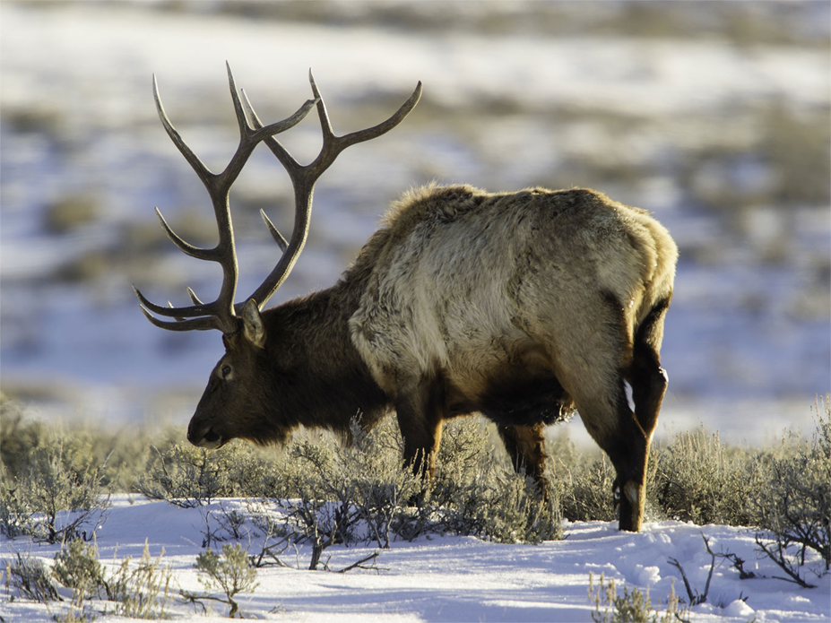
Unit 2 Lesson 2
Chemical Energy
MODEL: Draw a simple flow chart to show how energy is transferred from the sun to the elk's cells.

Slide 19
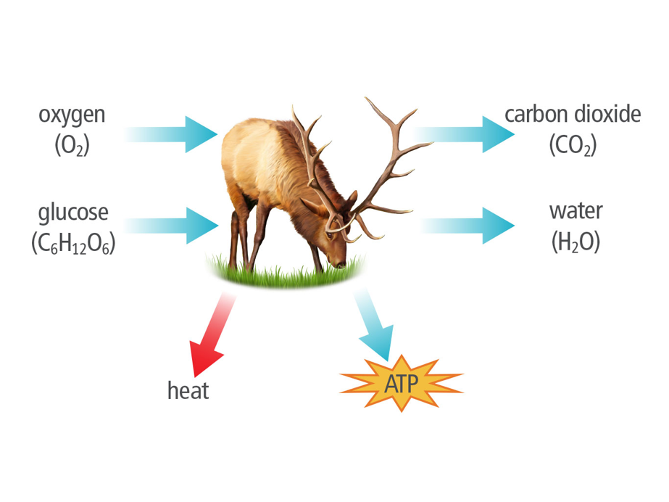
Chemical Energy and ATP
Unit 2 Lesson 2
Cellular respiration transfers energy from organic molecules such as glucose to a molecule called ATP, or adenosine triphosphate.
ATP is known as the energy currency of the cell.

Slide 20
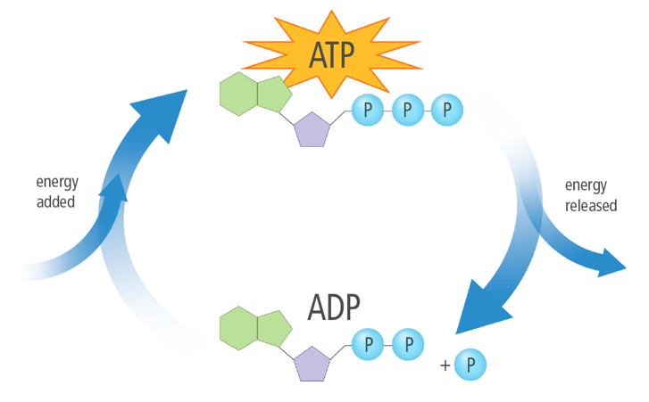
Chemical Energy and ATP Energy and Matter
Unit 2 Lesson 2
Cellular respiration is a multistep process that transfers chemical energy from glucose to ATP, which provides energy for cell processes.
Make an analogy to explain the role of ATP in storing energy and releasing energy for cell processes.

Slide 21
Chemical Energy and ATP
Unit 2 Lesson 2
EXPLAIN
A common misconception is that proteins are a good source of energy. Explain which types of foods are the best energy sources and how this relates to the amount of ATP made by your cells.

Slide 22
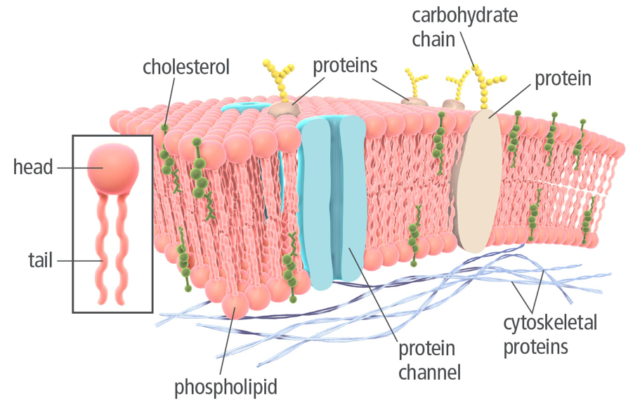
Unit 2 Lesson 2
The Cell Membrane
The cell membrane, or plasma membrane, has a specialized structure that allows the cell to control the passage of materials into and out of the cell.
The cell membrane is made of two phospholipid layers embedded with other molecules, such as proteins, carbohydrates, and cholesterol

Slide 23
Unit 2 Lesson 2
The Cell Membrane Hands-On Lab: Modeling the Cell Membrane
Make a model to investigate the properties of the cell membrane.

Slide 24
Unit 2 Lesson 2
The Cell Membrane Hands-On Lab: Heat and Diffusion
You can see diffusion in action when you add food coloring to water. In this lab, you will measure the rate of diffusion in water at three different temperatures.

Slide 25
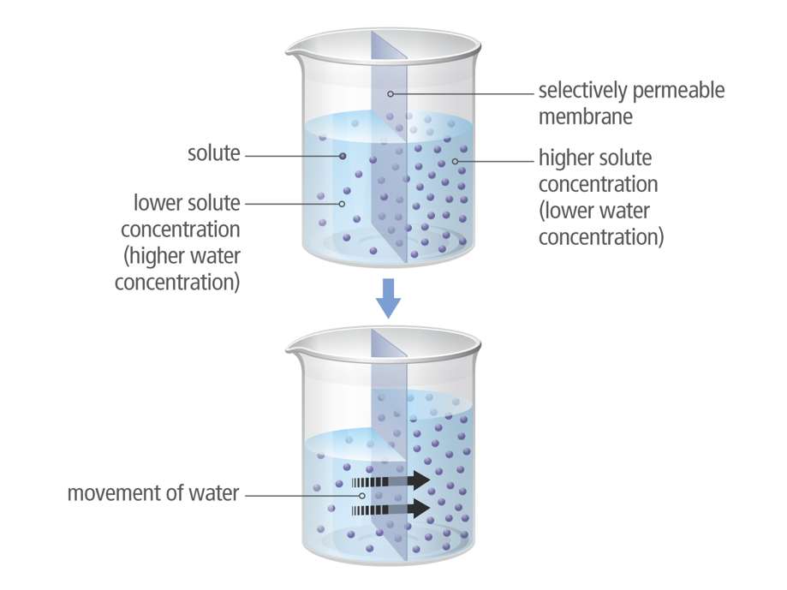
Unit 2 Lesson 2
Osmosis
Water molecules, of course, also diffuse.
They move across a semipermeable membrane from an area of higher water concentration to an area of lower water concentration.
This process is called osmosis.

Slide 26
Unit 2 Lesson 2
Osmosis
MODEL
Red blood cells burst when placed in pure water. Draw a model explaining this phenomenon. Label semipermeable membrane, solute concentration, and movement of water on your model.

Slide 27
Unit 2 Lesson 2
Osmosis
EXPLAIN Cystic fibrosis is a disease that occurs when a protein that normally transports ions across the cell membrane does not function properly. A change to the tertiary structure of the protein prevents it from transporting chloride ions out of cells. This leads to a lack of water outside the cells, which causes a sticky mucus to form in the lungs. Explain how diffusion and osmosis are related to the symptoms of cystic fibrosis.

Slide 28
Unit 2 Lesson 2
Continue Your Exploration
Choose one of the paths below to continue your exploration:
Investigating Osmosis
Food and Energy
Building Blocks of Plants
Modeling Biochemical Compounds

Slide 29
Can You Explain It?
Unit 2 Lesson 2
How can carbon be the central component of so many different types of molecules? Write an explanation that answers these questions:
How do the properties of carbon allow it to form a variety of different molecules?
What evidence is there that chemical reactions in organisms' cells break apart and rearrange carbon-based molecules?
How is energy from biomolecules transferred to cell processes in living things?

Slide 30
Image Credits
Unit 2 Lesson 2
diamond ©AptTone/Shutterstock; plant ©Pekka Nikonen/Shutterstock; carbohydrates ©Elena Schweitzer/Shutterstock; white otter ©neelsky/Shutterstock; nutrition labels ©Spauln/E+/Getty Images; hamster ©otsphoto/Shutterstock; elk ©Frank Pali/age fotostock/Getty Images

